Slide 1
Design Digitaler Schaltkreise
Semicustom Design Flow introduction

Slide 2
Lecture Goal
Introduce System Level Design
Basic concept of Hardware Description Development
Introduce Digital Implementation flow
Rapid overview
Some other lectures will go more in details:
Verilog Design
Synthesis
Place and Route 1/2
Übung
Design and Plan
Comments are welcome

Slide 3
System level basics

Slide 4
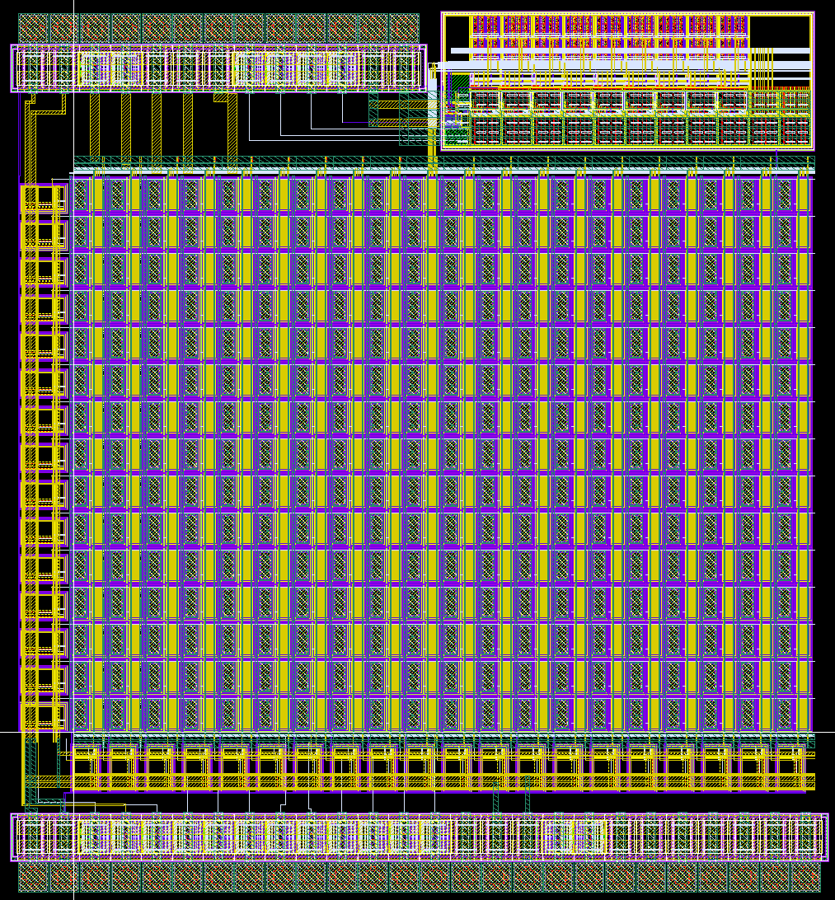
System Example: Mixed-Signal Sensor
Full Custom Digital Readout:
- Hit or !Hit
Light
Sensor Diode
Analog:
- Amplifier
- Comparator
Digital Silicon Photo Multiplier – 350nm – May 2016

Slide 5
System Example: Complex System on Chip
Support Blocks (PLL, test etc..)
CPU
Cores
Routing channels
I/O Cells
GPUs
Iphone A6 APU – 28nm (picture from chipworks.com)

Slide 6
Stakes in Complex Digital Designs
Features Size decreases, now 65nm is easy to access, next “standard” node for mere mortal is around 28nm, maybe 14nm
Consequences:
More features per ASIC -> System on Chip
Each feature gets bigger -> Design and Implementation Cost higher
System Implementation stakes:
Difficult: Register Transfer level design and verification
Difficult: System Physical Planning and constraining
Actual implementations: the tools do the job
Costs Location:
Hardware Designer Time
Specification / IP Blocks
Computation time leads to project-parallelizing

Slide 7
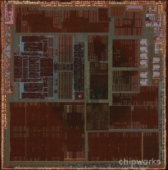
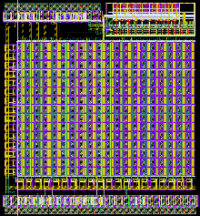
Analog and Digital implementation Flows
System
Digital
Analog
Logic Description (code)
Schematic Circuit
Fix
Circuit Synthesis
Technology Mapping
IPBlocks; Cells
“Hand-Crafted” Layout
Place and Route
Custom Integration
Semi Custom
Full Custom

Slide 8
ASIC vs FPGA design
We are interested in Digital ASIC target, not FPGA target
RTL-Level (Verilog/VHDL) design is very similar
FPGA
FPGA is a build system with pre-available resources
Synthesis maps to those functions
Place and route creates configuration file for routing
Design size and speed is limited
ASIC:
Every component must be provided and placed
Example: SRAM memories
Example: PLL
Design can be big
But it’s expensive
Key Point: Resources like RAM/PLL
What can I get at what Price ?
ASIC: Buy more IP? Develop them?
FPGA: Buy a bigger device ?

Slide 9
System Design Phases
Digital System Specification
HDL Design
Constraints
System Verification
(simulation)
Implementation
Timing
Physical
Power
Incremental Changes

Slide 10
Design Flow Overview

Slide 11
Simplified Overview
Abstract: Hardware Description (HDL = Verilog/VHDL) + Tools
Concrete: Technology Valid implementation
Tools
generate
Verilog/VHDL
Standard Cells
Physical Implementation
write
Synthesis/Map
Place & Route

Slide 12
Hardware Description Methodology
HDL - Register Transfer Level (RTL)
Verilog / VHDL
System Verification and Metrics
Simple test benches
Complex Functional Verification
UVM with SystemVerilog/e-Language
Assertions
“Inline” signal dependencies check
Coverage
Detect logic usage
Software Supported design
Abstract tools for easy design
FSM designers
Registerfile generator
HDL generator
Etc…
Language: Often Tool Command Kit (TCL)
Requires good software skills to develop tools
Verification
HDL

Slide 13
HDL - Functional Verification
clk
counter
Verification of Logic by Simulation
The design is called a Device Under Test (DUT)
The Simulation is driven by a testbench:
Change the Inputs
Monitor the outputs (“eye” control or software comparisons)
Test if the outputs are matching specification
The testbench is written in Verilog/VHDL as well…
…but it is just like a software (can use threads etc…)
Testbench type examples:
Simple Verilog File driving a small design (“eye” control)
Complex Object-Oriented environment with data randomisation like Universal Verification Methodology (UVM)
res_n
value
clear
hold
Simple Test Bench
Test
code
DUT
Monitor
+1 on clock
Hold
Success
Failure

Slide 14
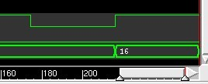
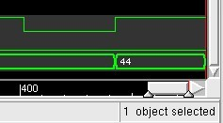
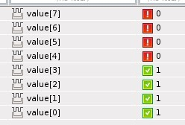
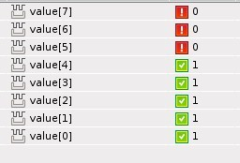
HDL - Coverage
Coverage gather statistics about the values of the signals encountered during simulation.
They are usually carefully designed
Typical usage:
A multibit value may be too large and not all the bits are required (ex: Defined 8 bits but value is never > 15 -> only 4 bits enough)
State machine states are represented by a value (ex 1,2,3 etc…). If a state is never matched, it is either not needed, or can indicate the source of a failure
Example for counter value:
Simulation:
0 -> 16 -> Stop
Simulation:
0 -> 44 -> Stop
4 bits hit
5 bits “hit”
Output from Coverage Analysis Tool

Slide 15
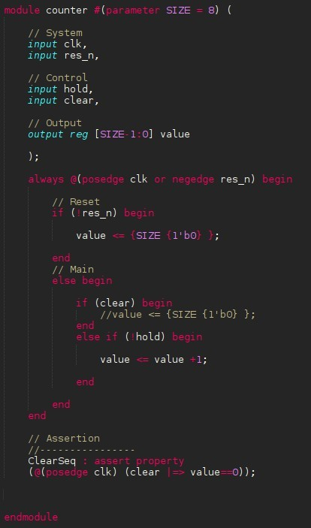
HDL - Assertions
“Inline” requirements for signal specification inside hardware module definition
Executed during simulation
Usually the simulation stops and fails on assertion error
Very convenient for specification enforcement
Example for counter: Clear behaviour
Clear is 1
Next Clock Cycle
Value is 0
Success
Failure
Counter Verilog code

Slide 16
Synthesis: Standard cell mapping
Start Point: HDL
Synthesis creates the logic circuit from HDL
Circuits is mapped to Standard Cells
Standard Cells are VLSI implementation of simple logic functions inside a standard sized block
Designs Kits provide standard cells
Each Cell is a logic function implementation:
Example: AND3 -> AND with 3 inputs
Timing is provided in Cell description
Example: Slow/Typical/Fast corners
Mapping is optimised:
Timing
Example: Use Low threshold cells
Area
Power
VDD
AND
AND4
Fixed Height
VSS
VDD
AND
AND
AND4
VSS
AND
VDD
Physical Placement organised in Rows

Slide 17
More standard cells
VDD
OUT
IN
-
Gate
Drain
Source
GND
AND
OR

Slide 18
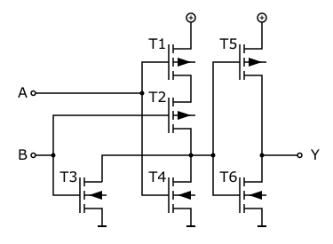
OR Function Working Principle
0 = PMOS On ; NMOS Off
1 = PMOS Off; NMOS On
PMOS
X
X
1
Serie
Q
0
1
0
1
0
0
X
A
B
NMOS
Parallel
Serie
A | B | Q
0 | 0 | 0
1 | 0 | 1
0 | 1 | 1
1 | 1 | 1
OR
Parallel

Slide 19
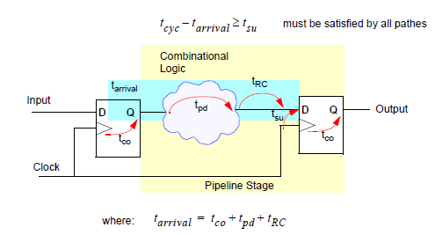
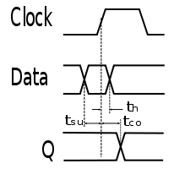
Synthesis: Static Timing Analysis (STA)
Lowest Level in Register Transfer Level
Register – Logic - Register
Timing Constraints:
Clock cycle definition
Input/Output Delays
STA:
D->Q time from FlipFlop
+ Logic (gates + interconnect) time
Must fit in the clock cycle
Check setup time: Too slow
Check hold time: Too Fast
Fixes happen along the whole implementation process
Picture: Uni. Heidelberg – LS Rechnerarchitektur

Slide 20
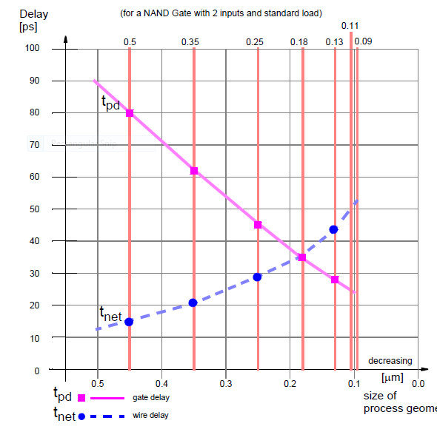
Synthesis: Static Timing Analysis (STA)
During Circuit mapping, the STA checks the timing paths
Two delay paths:
Gate Delay: Given by Standard Cell Specification
Wire Delay: Interconnection
Wire Delay:
Small feature size makes wire delay predominant
Need for physical synthesis

Slide 21
Synthesis: Physical Synthesis
HDL
Map/Optimize
Fast Place and Route
Extraction
Physical part
Gates Netlist
Verilog file with module instances
Modules are Standard Cell instances
.AND(a,b,net1);
.OR(c,net1,net2);

Slide 22
Place and Route overview
Gates Netlist
Physical Constraints for physical synthesis
Floorplan
Power Struct.
Place
Clock Tree
Route
Core area
Cells from netlist
Block placement
I/O Ring
Power stripes
Cell rows

Slide 23
Design For test
After Production, sort:
Working Ics
Defect Ics
Defects/Working = Yield
Tests types:
Optical defect detection
Flip-Flop test patterns: JTAG
Self test for some blocks
SRAM memories have self testing
System level test function (like a testbench but in real life)
When to test
Wafer level during manufacturing
Expensive
In Lab/Facility using system level tests
How to implement tests
Test patterns can be added during synthesis
System Level:
Embedded test functionality
System test: Setup a system and see what happens
Test probes
ICs
Defect marker
Wafer level test example

Slide 24
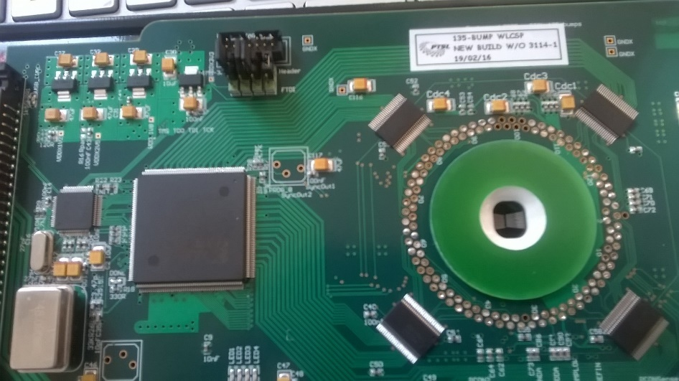
Wafer Level / Single Chip Test example
Probe Card with an FPGA
Software drives the Input/Output of the ASIC
Data is readout and Measurements saved to qualify the ASIC
Can be done in chain with the help of a camera driven XYZ table
Probe Card Tester for Belle 2
(ASIC in AMS 180um HV process)
Wafer or Single Chips

Slide 25
Übung

Slide 26
Content
Goal: Lear to use Industry tools and get used to the design flow
HDL Design
Very Simple Hardware Design to learn Verilog/VHDL
One or multiple counter types is enough
More Complex System: See PSOC Praktikum im WS16
Simulation using Cadence INSICIV suite
Synthesis
Synthesis to a Generic 45nm technology
Learn about technology data, Logic Cell types etc…
See some synthesis options like Clock Gating , Reset Types, Physical Synthesis…
Simulation of Synthesised design
Implementation
Place the Design in a “ready to produce” ASIC
Prepare Chip Constraints:
Target Clocks
I/O Delays
Floorplan
Go through physical implementation with timing checks
Simulation of placed design with timing information

Slide 27
Tools: Cadence INSICIV and EDI suites
Simulation: “irun” tool from INSICIV Cadence Suite
Programming: TCL Language
Synthesis:
Cadence RTL Compiler
Place and route
Cadence First Encounter
Also called during physical synthesis
Unlike Analog Design tools:
Write TCL scripts
TCL contains function calls for various steps:
read_design
elaborate
read_constraints
synthesize –to_placed
GUI View:
See the results of scripts run mostly
Analyse Timing

Slide 28
Übung organisation
Groups of ~20
2 groups
Every 2 weeks
Begin: 12th May
Where/When: Thursdays 14h00 at IMS (Westhochschule)
Registration on ILIAS
Overlap with ITIV Hardware Design Lab: OK
HD-Lab is ok as DDS Übung
Maybe we will run synthesis on HD-Lab content at the end of semester

Slide 29
End Slide!

